Slide 1




Smart Exam Administration System
Ali Emre Öz
Fatih Çağatay Gülmez
Muhammed Yasin Yıldırım
Supervised by Asst. Prof. Ali Çakmak

Slide 2



About
Problem Definition
Our Solution
Background
Aims

Slide 3
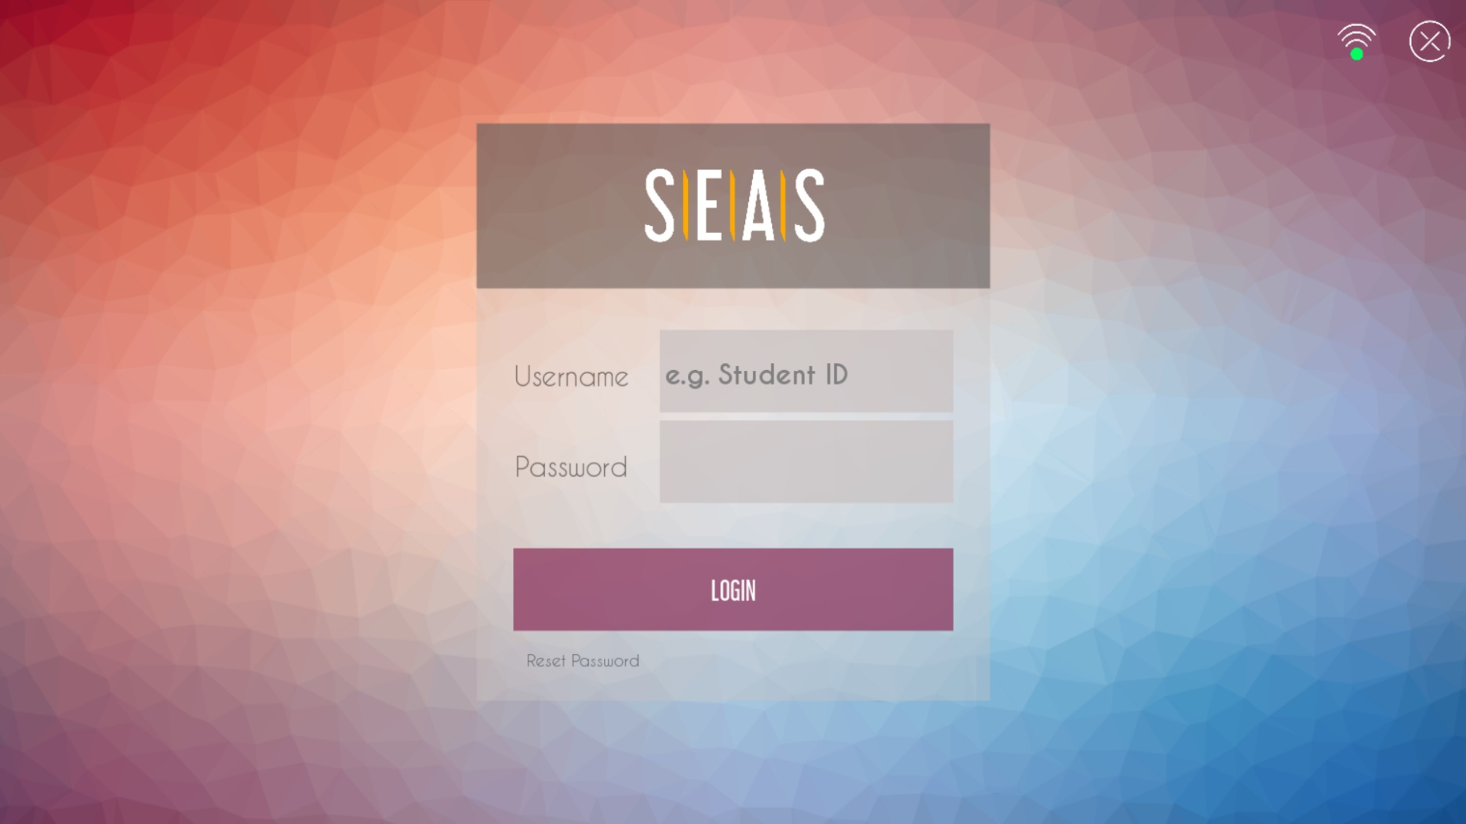

Graphical User Interface
Why Kivy?
kivy
Cross Platform
Free To Use
Open Source

Slide 4
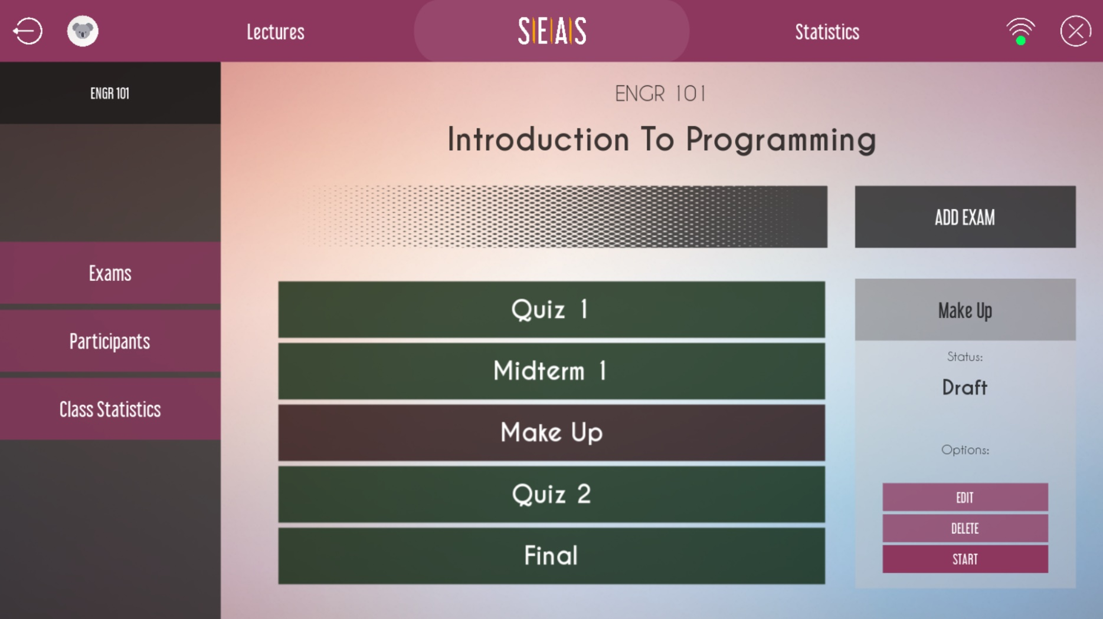



Graphical User Interface
Design
Compatible
Responsive

Slide 5
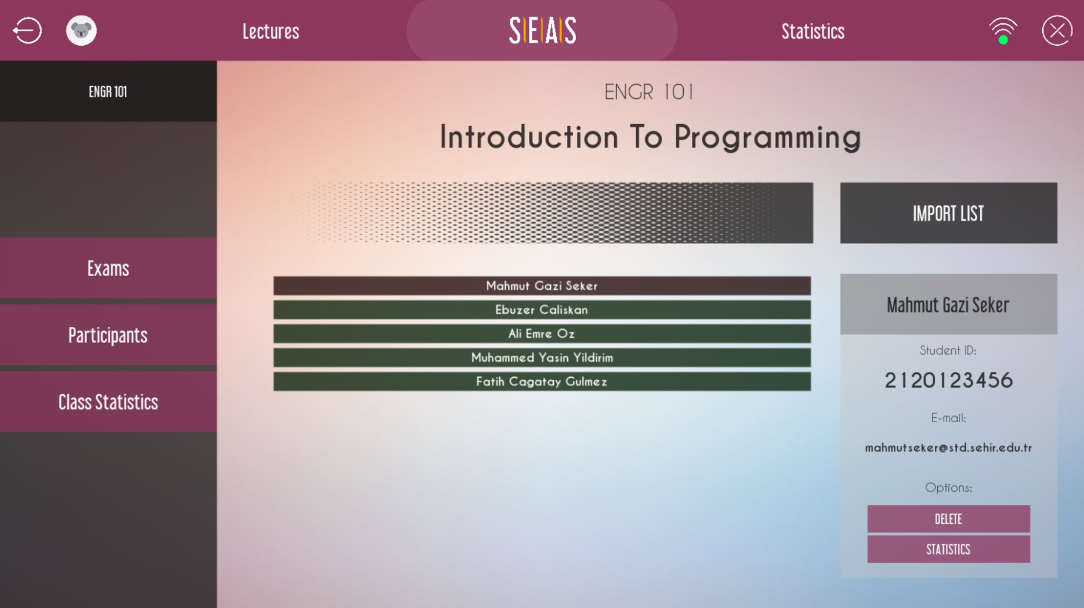
Functionality
Student Registration

Slide 6
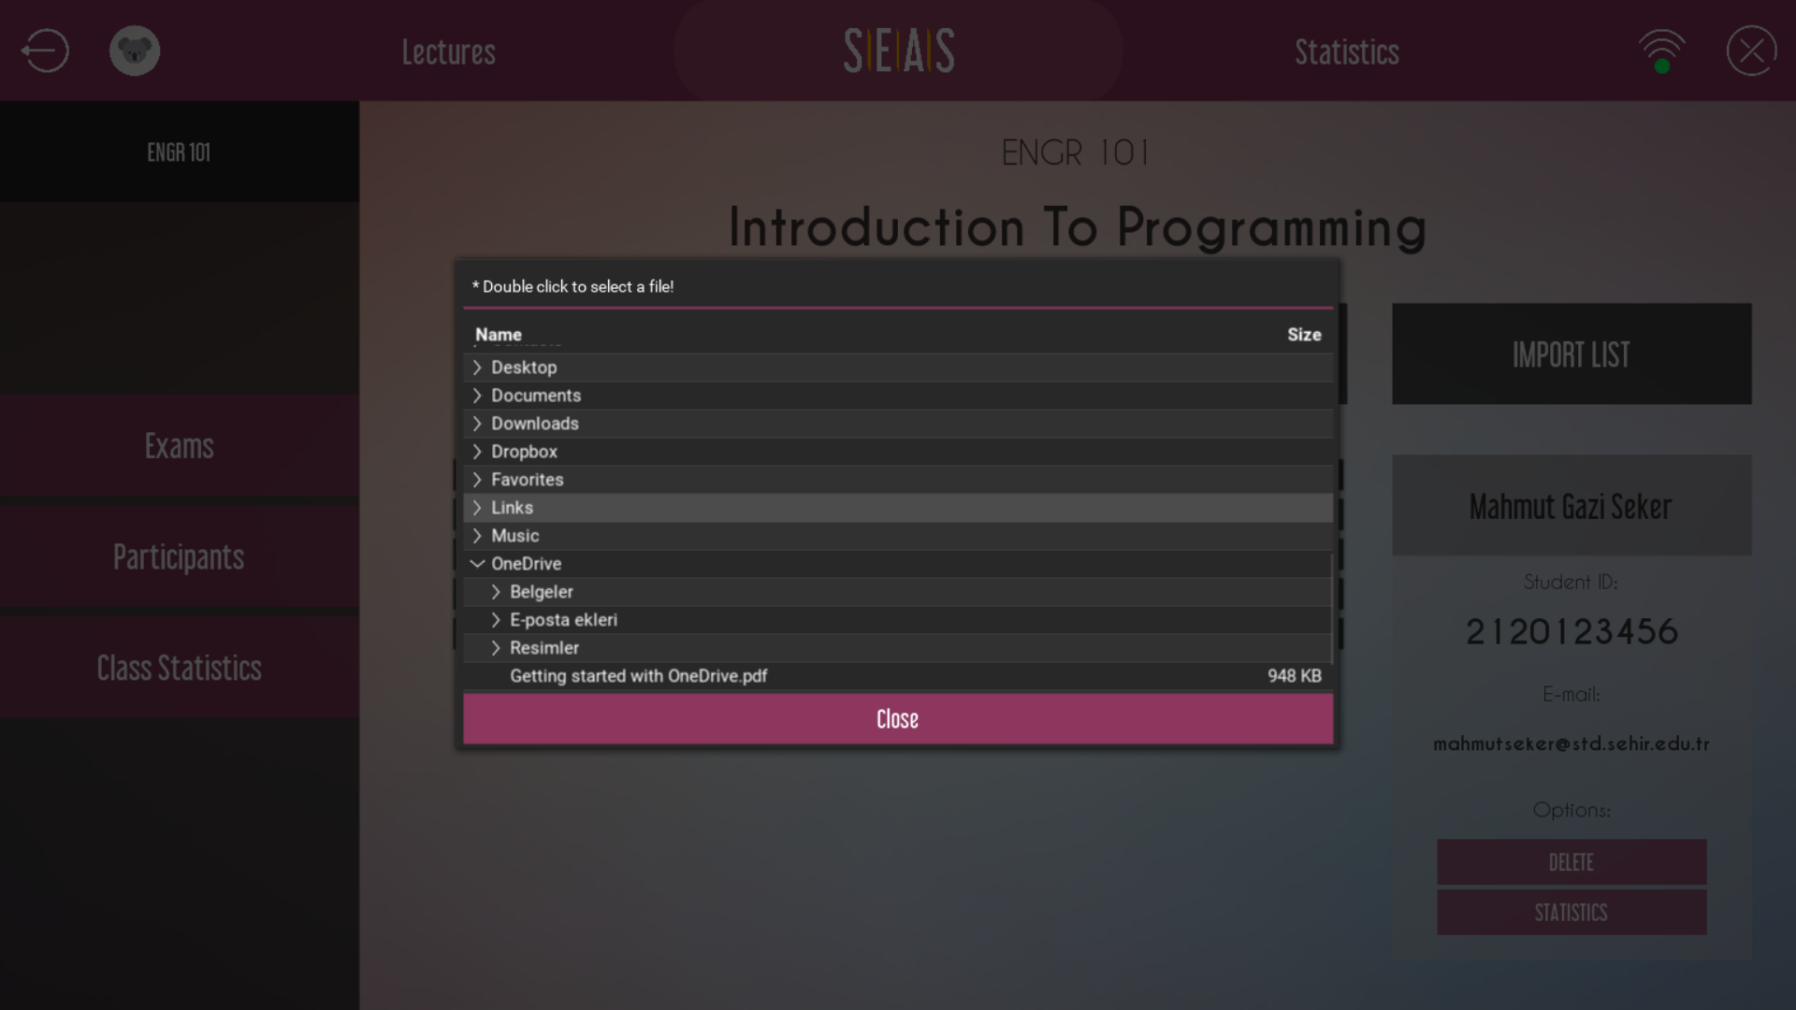
Functionality
Student Registration

Slide 7

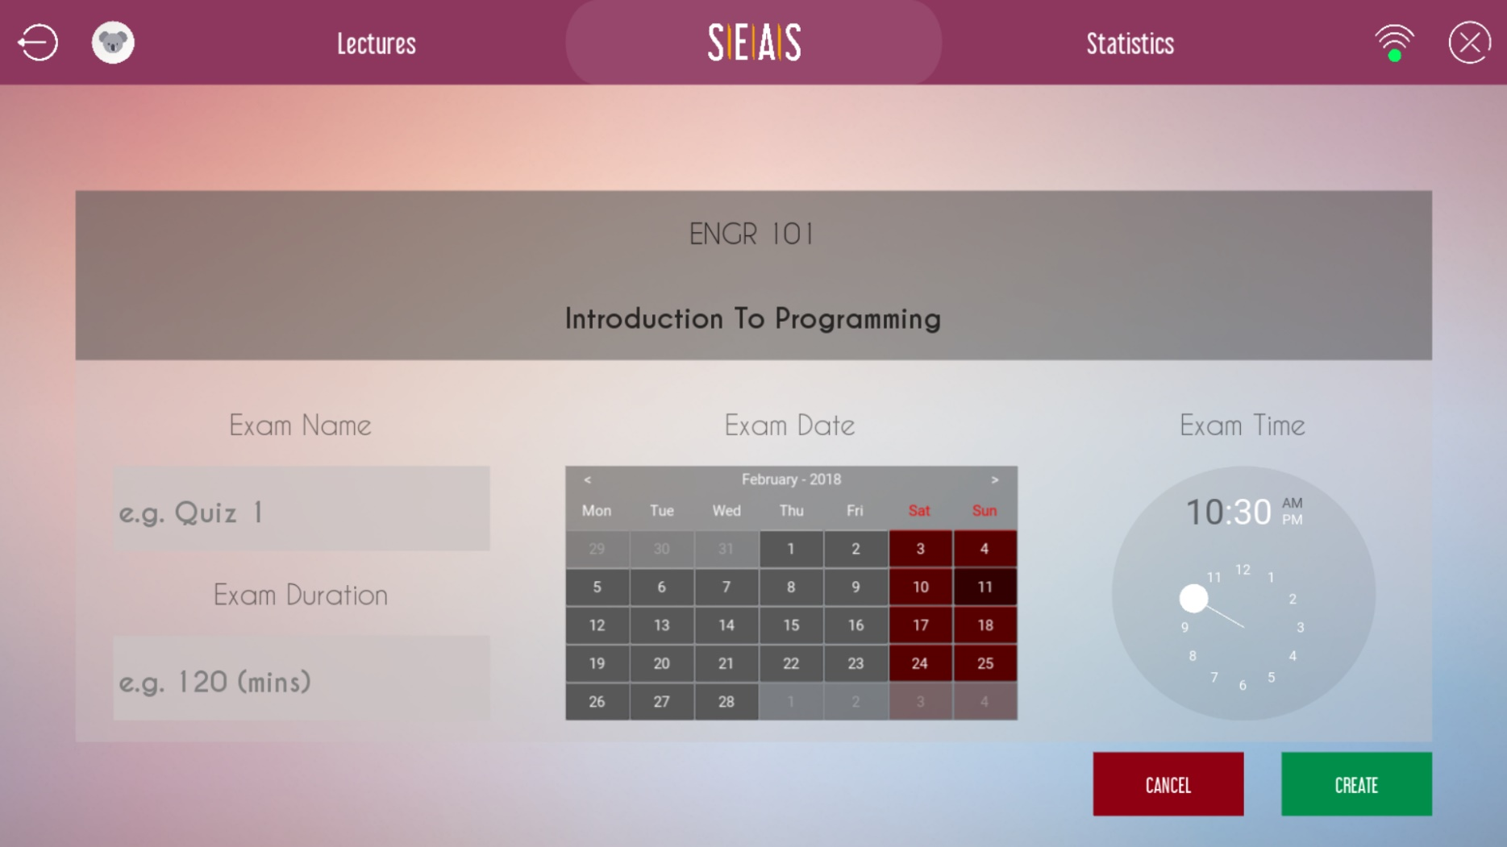
Functionality
Computer Based Examination

Slide 8
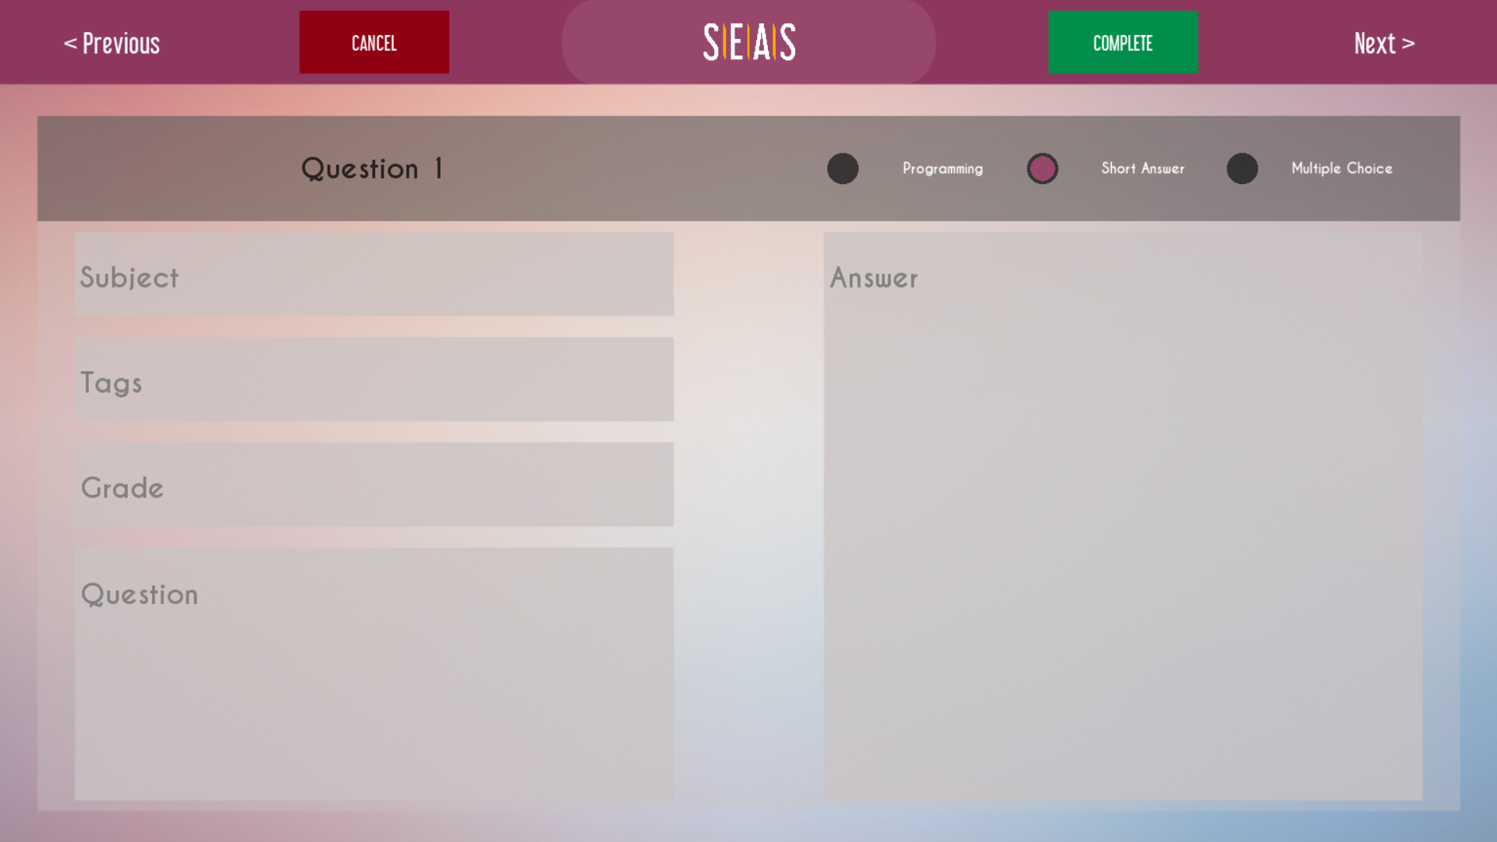
Functionality
Computer Based Examination

Slide 9
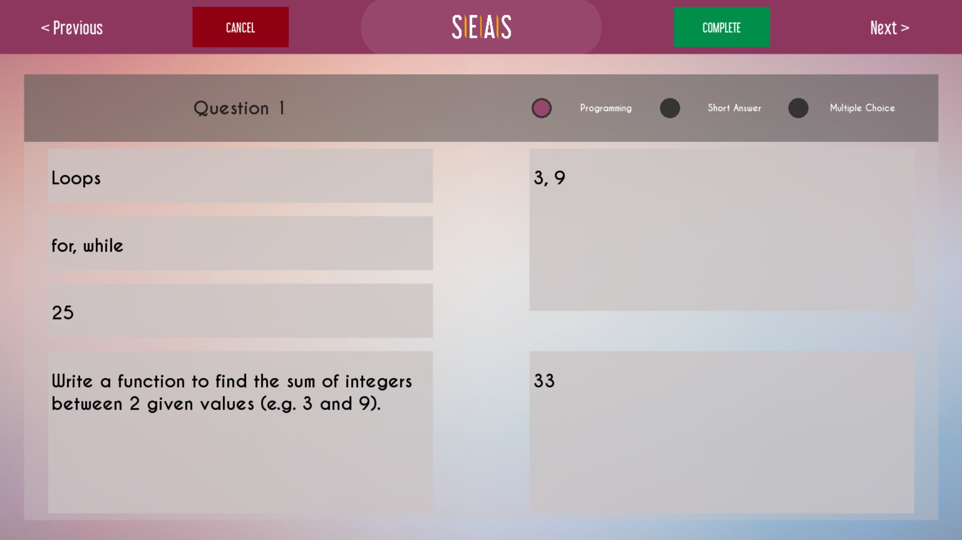
Functionality
Computer Based Examination

Slide 10
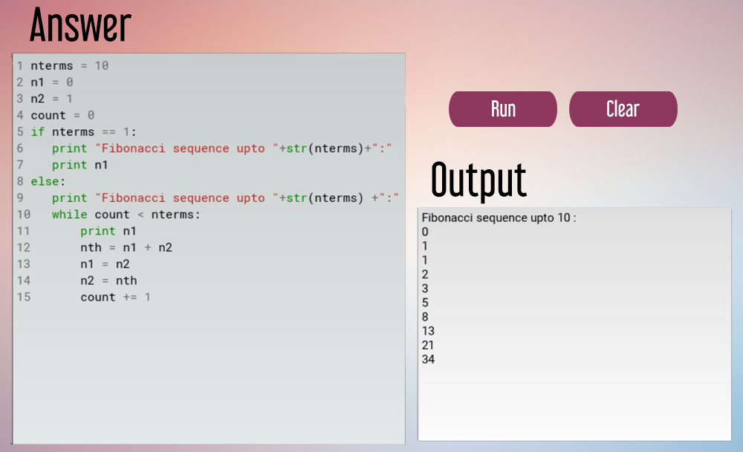
Functionality
Code Compiler

Slide 11
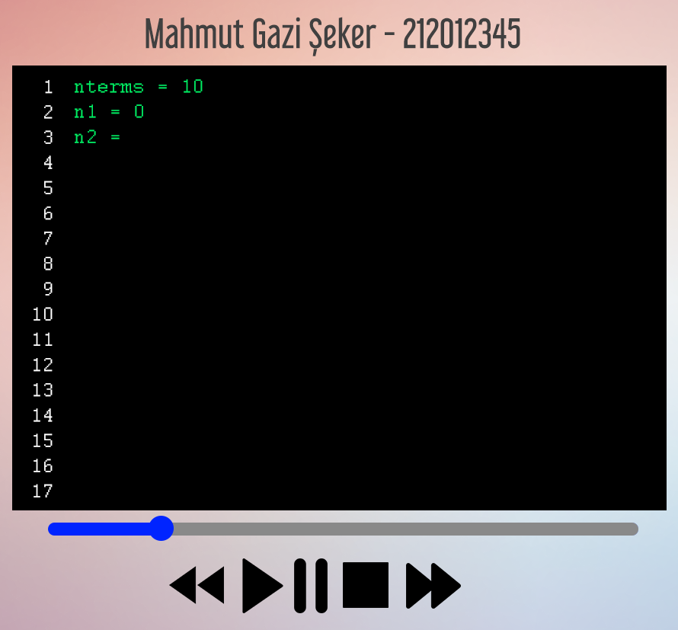
Exam Security
Live Monitoring

Slide 12
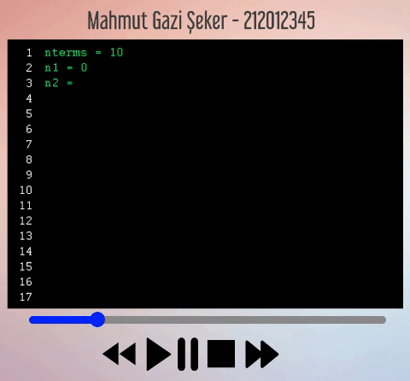
Exam Security
Live Monitoring

Slide 13

Exam Security
Preventing External Sources
Force on-top
Force fullscreen
Key blocking

Slide 14

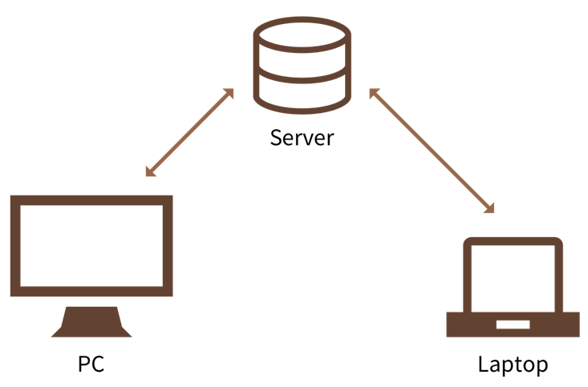

Server Side
Abstraction of System

Slide 15

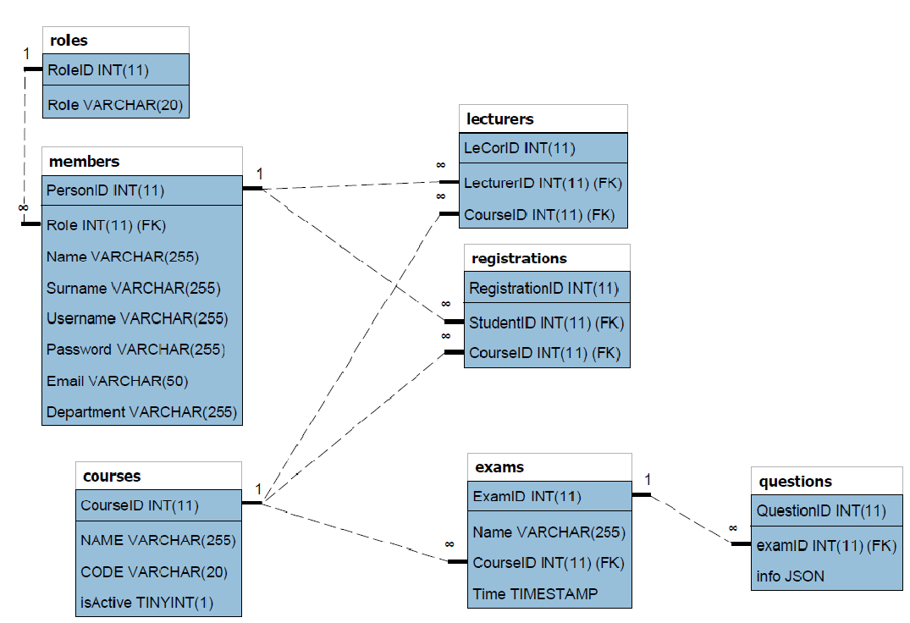
Server Side
Database Structure

Slide 16
Future Plans
Machine Learning Supported Anti-Cheating System
Token Based Server Security
Post-Exam Statistics and Graphs
Live Streaming with Peer-to-Peer
Cloud Deployment (AWS, Azure…)
Load Balance Optimization
Mobile Support for Lecturers

